Slide 1
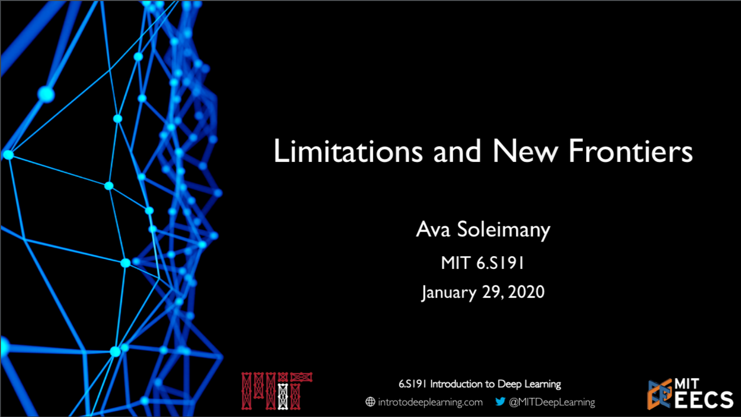

Slide 2
So far in 6.S191

Slide 3
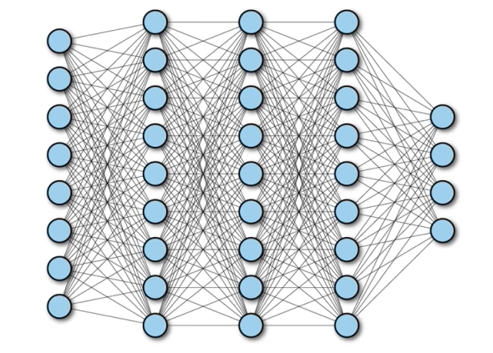
Power of Neural Nets
Universal Approximation Theorem
A feedforward network with a single layer is sufficient to approximate, to an arbitrary precision, any continuous function.

Slide 4
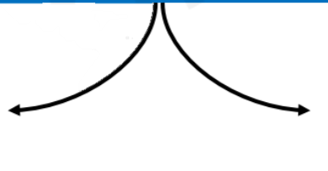
Power of Neural Nets
Universal Approximation Theorem
A feedforward network with a single layer is sufficient to approximate, to an arbitrary precision, any continuous function.
Caveats:
The number of hidden units may be infeasibly large
The resulting model may not generalize

Slide 5
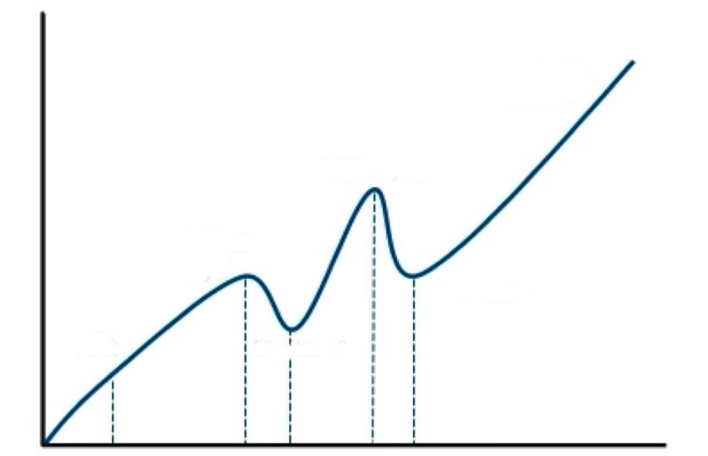
Artificial Intelligence “Hype”: Historical Perspective
Popularity
Explosive Growth
New Hopes
Inflated Hype
AI winter II
Birth
AI winter I
1965
1980
1993
Time
1950
1974
1987

Slide 6
Limitations

Slide 7
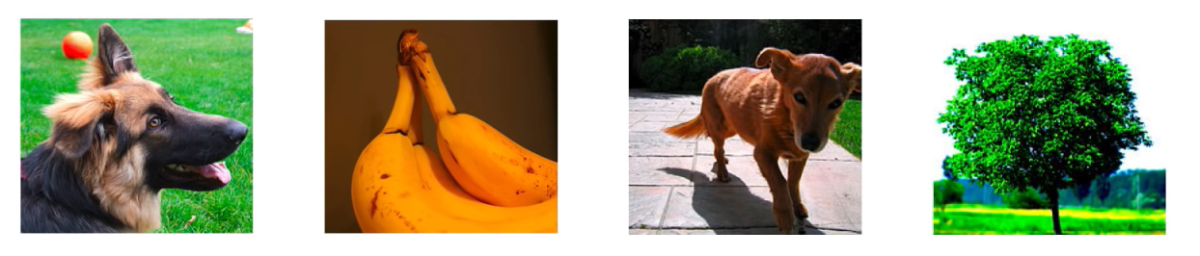
Rethinking Generalization
“Understanding Deep Neural Networks Requires Rethinking Generalization”
dog
banana
dog
tree

Slide 8
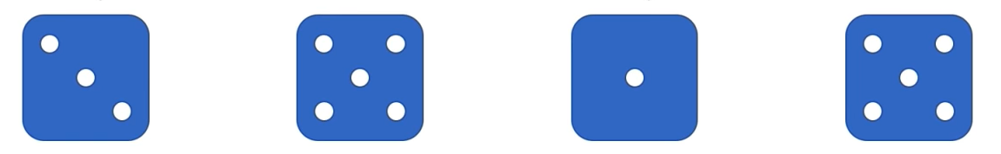
Rethinking Generalization
dog
banana
dog
tree

Slide 9
Rethinking Generalization
dog
banana
dog
tree
banana
dog
tree
dog

Slide 10
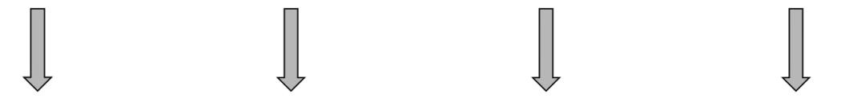
Rethinking Generalization
dog
banana
dog
tree
banana
dog
tree
dog

Slide 11
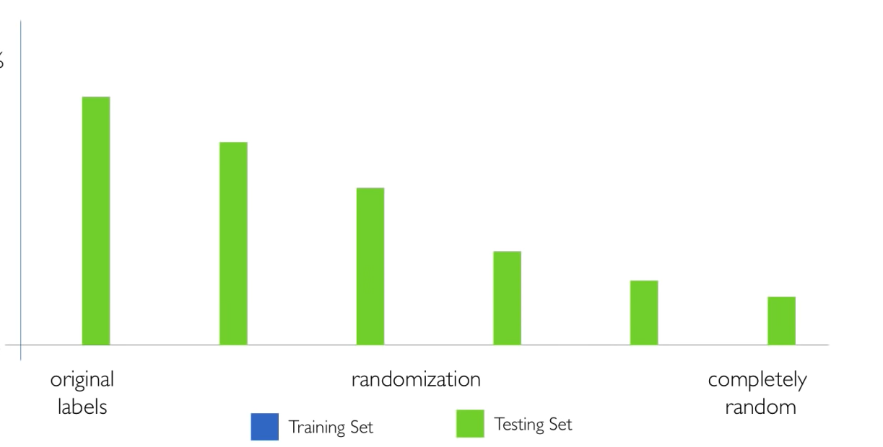
Capacity of Deep Neural Networks
100%
accuracy
0%
original labels
randomization
completely random
Training set
Testing set

Slide 12
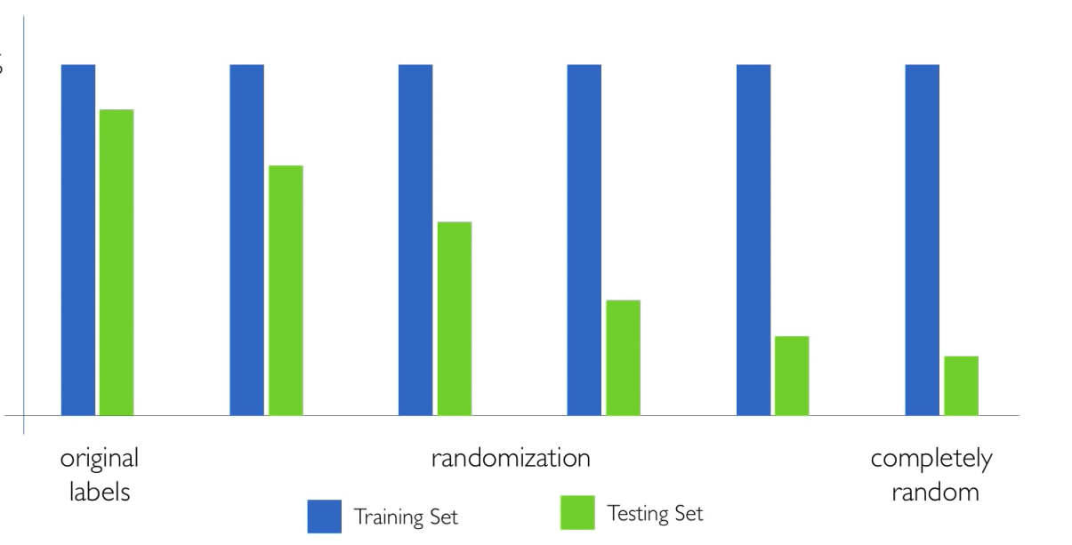
Capacity of Deep Neural Networks
100%
accuracy
0%
original labels
randomization
completely random
Training set
Testing set

Slide 13
Capacity of Deep Neural Networks
Modern deep networks can perfectly fit to random data
100%
accuracy
0%
original labels
randomization
completely random
Training set
Testing set

Slide 14
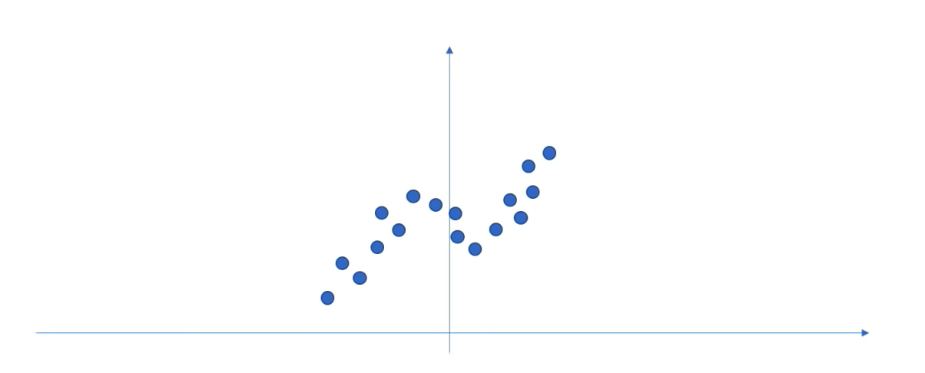
Neural Networks as Function Approximators
Neural networks are excellent function approximators
© Alexander Amini and Ava Soleimany MIT 6.S191: Introduction to Deep Learning IntroToDeepLearning.com

Slide 15
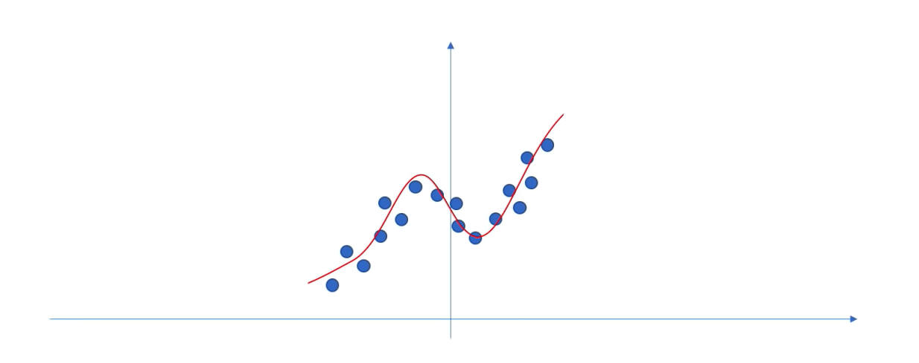
Neural Networks as Function Approximators
Neural networks are excellent function approximators
© Alexander Amini and Ava Soleimany MIT 6.S191: Introduction to Deep Learning IntroToDeepLearning.com

Slide 16

Neural Networks as Function Approximators
Neural networks are excellent function approximators
© Alexander Amini and Ava Soleimany MIT 6.S191: Introduction to Deep Learning IntroToDeepLearning.com

Slide 17
Neural Networks as Function Approximators
Neural networks are excellent function approximators
© Alexander Amini and Ava Soleimany MIT 6.S191: Introduction to Deep Learning IntroToDeepLearning.com

Slide 18
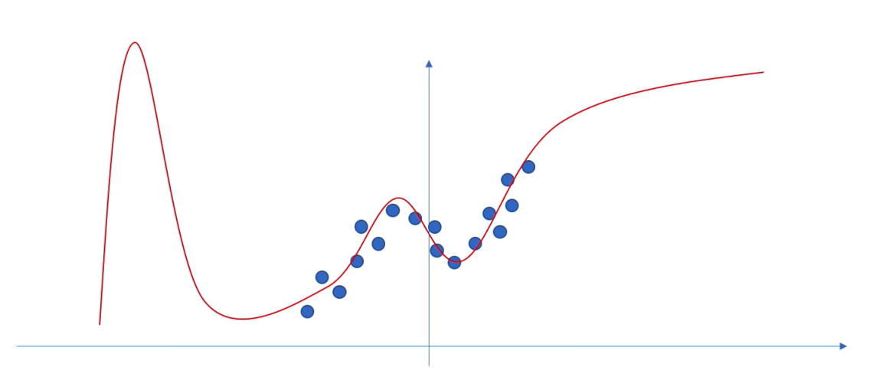
Neural Networks as Function Approximators
Neural networks are excellent function approximators
© Alexander Amini and Ava Soleimany MIT 6.S191: Introduction to Deep Learning IntroToDeepLearning.com

Slide 19
Neural Networks as Function Approximators
Neural networks are excellent function approximators
…when they have training data
How do we know when our network doesn’t know?
© Alexander Amini and Ava Soleimany MIT 6.S191: Introduction to Deep Learning IntroToDeepLearning.com

Slide 20
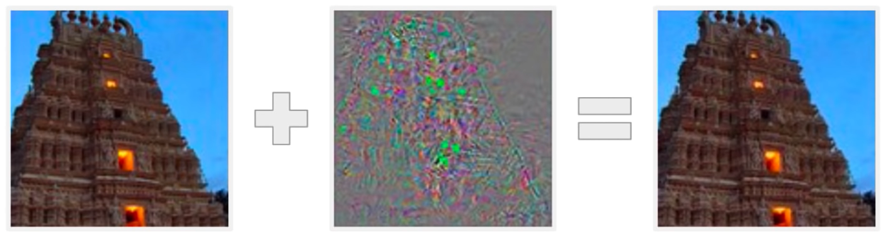
Adversarial Attacks on Neural Networks
Original Image
Perturbations
Adversarial example
Temple (97%)
Ostrich (98%)

Slide 21

Adversarial Attacks on Neural Networks
Original Image
Perturbations
Adversarial example
Temple (97%)
Ostrich (98%)

Slide 22
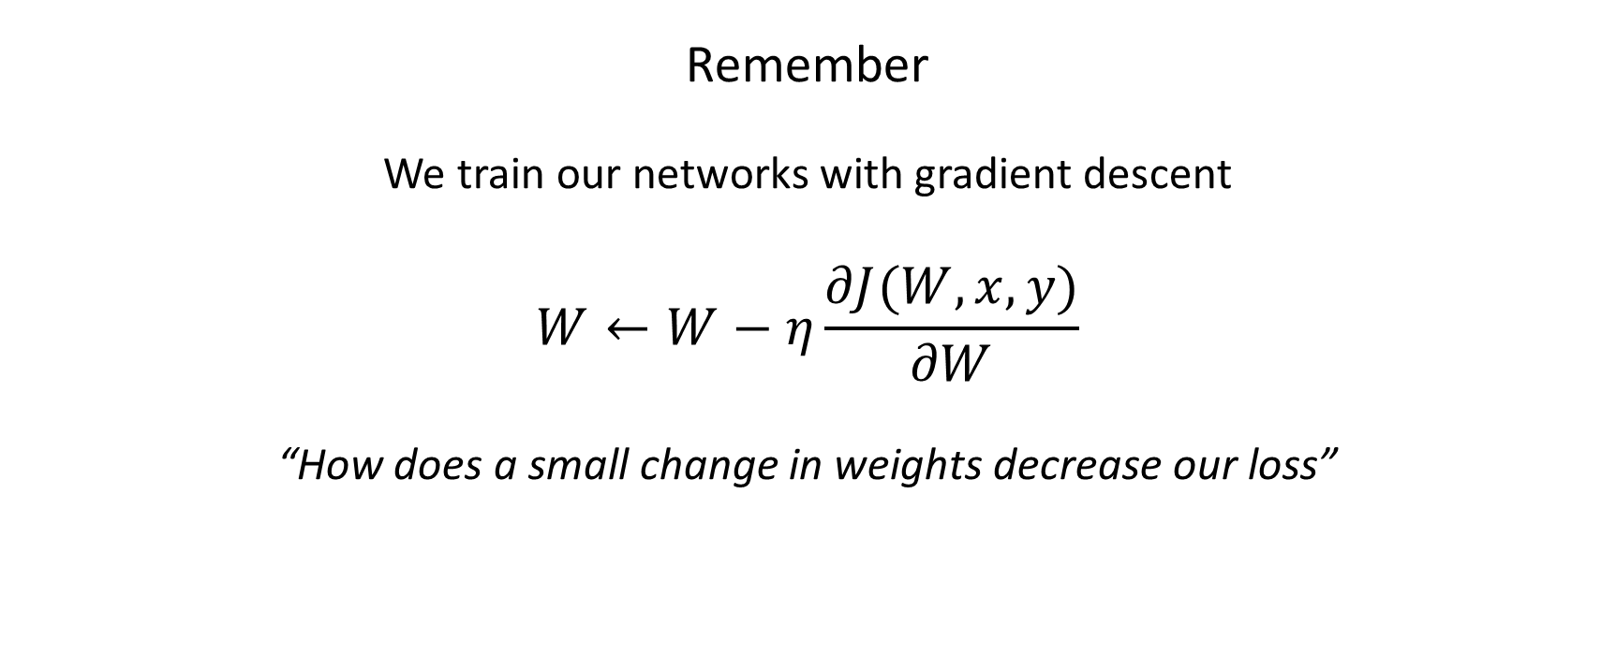
Adversarial Attacks on Neural Networks
Remember
We train our networks with gradient descent
$$W←W−η\frac{∂J(W, x, y)}{∂W}$$
“How does a small change in weights decrease our loss”

Slide 23
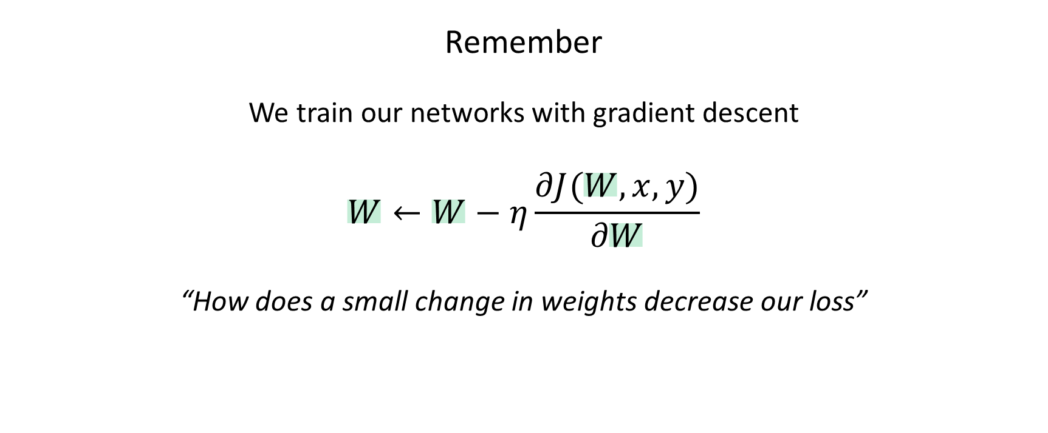
Adversarial Attacks on Neural Networks
Remember
We train our networks with gradient descent
$$W←W−η\frac{∂J(W, x, y)}{∂W}$$
“How does a small change in weights decrease our loss”

Slide 24
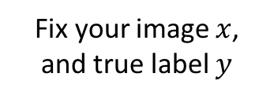
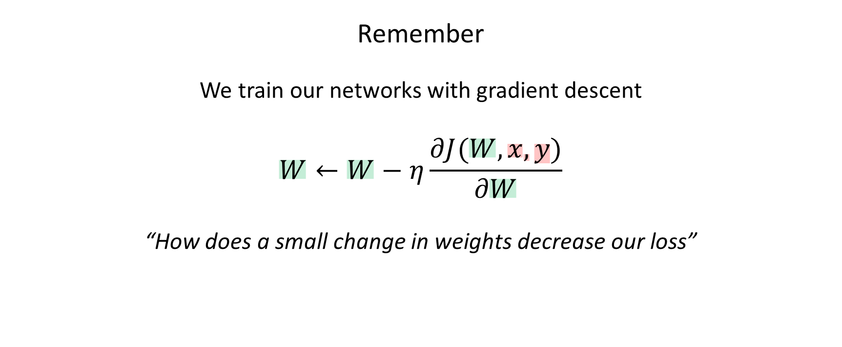
Adversarial Attacks on Neural Networks
Remember
We train our networks with gradient descent
$$W←W−η\frac{∂J(W, x, y)}{∂W}$$
“How does a small change in weights decrease our loss”
Fix your image $x$, and true label $y$

Slide 25
Adversarial Attacks on Neural Networks
Remember
We train our networks with gradient descent
$$W←W−η\frac{∂J(W, x, y)}{∂W}$$
“How does a small change in weights decrease our loss”
Fix your image $x$, and true label $y$

Slide 26
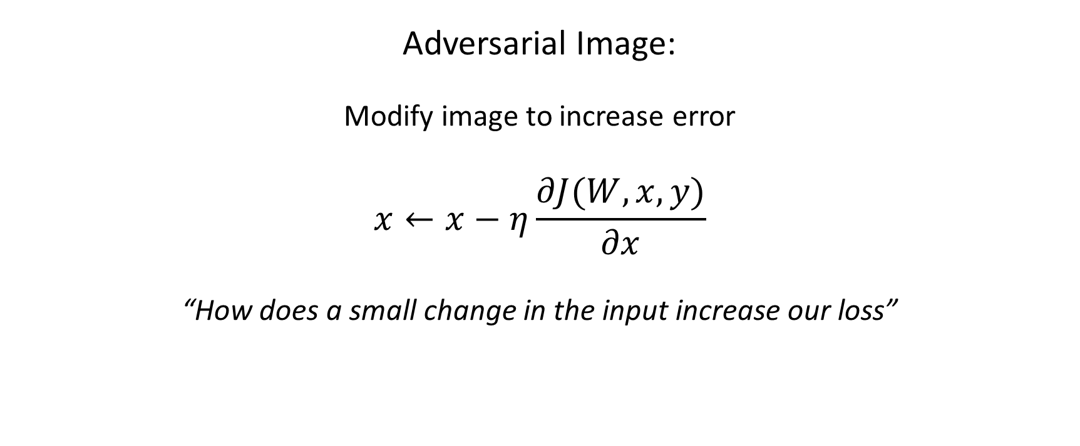
Adversarial Attacks on Neural Networks
Adversarial Image:
Modify image to increase error
$$x←x−η\frac{∂J(W, x, y)}{∂x}$$
“How does a small change in the input increase our loss”

Slide 27
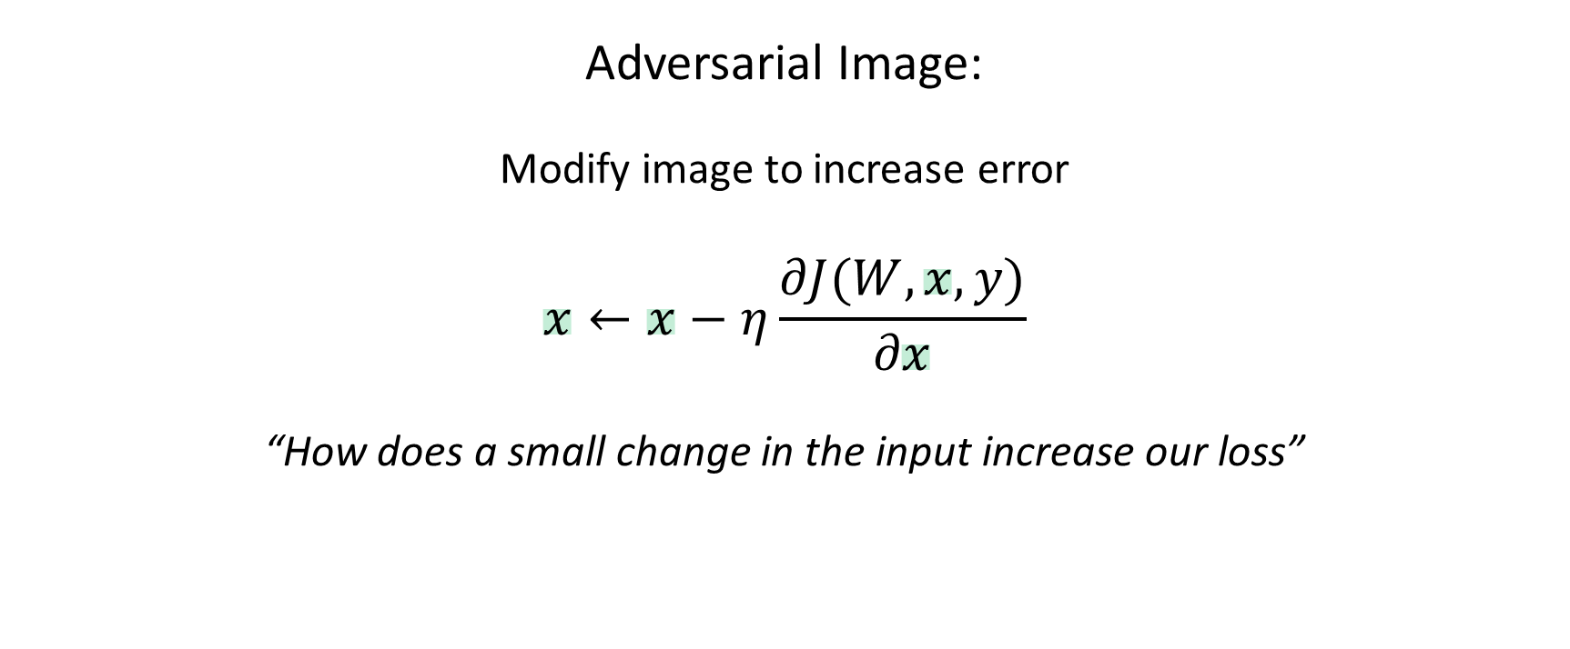
Adversarial Attacks on Neural Networks
Adversarial Image:
Modify image to increase error
$$x←x−η\frac{∂J(W, x, y)}{∂x}$$
“How does a small change in the input increase our loss”

Slide 28
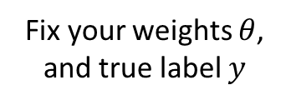
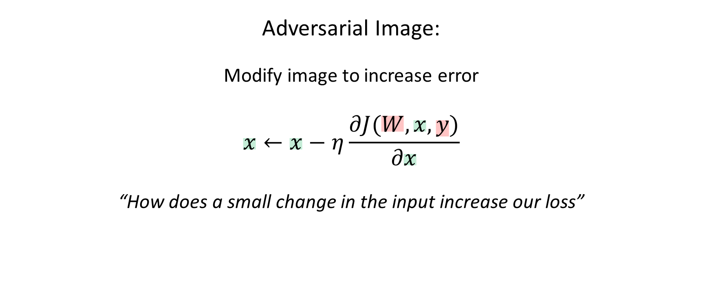
Synthesizing Robust Adversarial Examples
Adversarial Image:
Modify image to increase error
$$x←x−η\frac{∂J(W, x, y)}{∂x}$$
“How does a small change in the input increase our loss”
Fix your weights $θ$, and true label $y$

Slide 29
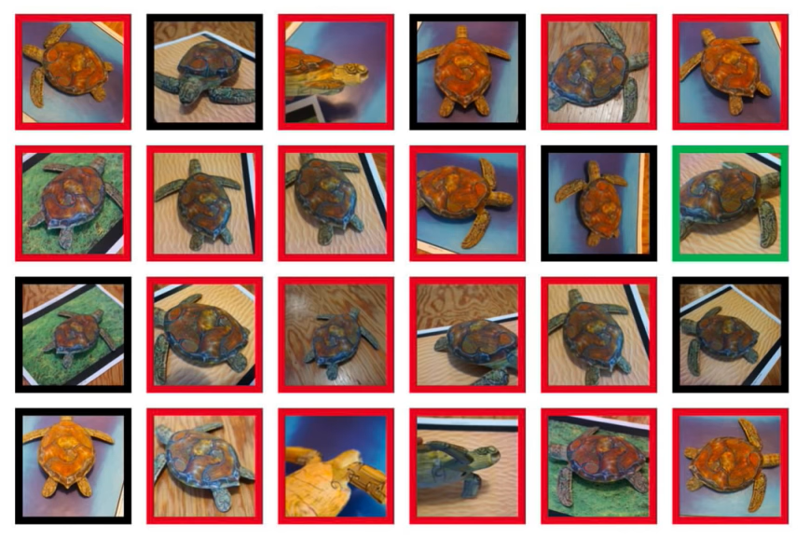
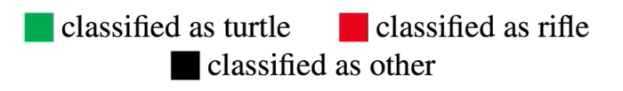
Synthesizing Robust Adversarial Examples
classified as turtle
classified as rifle
classified as other

Slide 30
Neural Network Limitations…
Very data hungry (e.g. often millions of examples)
Computationally intensive to train and deploy (tractably requires GPUs)
Easily fooled by adversarial examples
Can be subject to algorithmic bias
Difficult to encode structure and prior knowledge during learning
Poor at representing uncertainty (how do you know what the model knows?)
Uninterpretable black boxes, difficult to trust
Finicky to optimize: non-convex, choice of architecture, learning parameters
Often require expert knowledge to design, fine tune architectures

Slide 31
Neural Network Limitations…
Very data hungry (e.g. often millions of examples)
Computationally intensive to train and deploy (tractably requires GPUs)
Easily fooled by adversarial examples
Can be subject to algorithmic bias
Difficult to encode structure and prior knowledge during learning
Poor at representing uncertainty (how do you know what the model knows?)
Uninterpretable black boxes, difficult to trust
Finicky to optimize: non-convex, choice of architecture, learning parameters
Often require expert knowledge to design, fine tune architectures

Slide 32
New Frontiers I:
Encoding Structure into Deep Learning

Slide 33
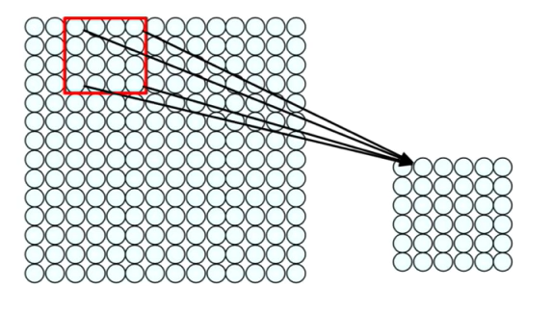
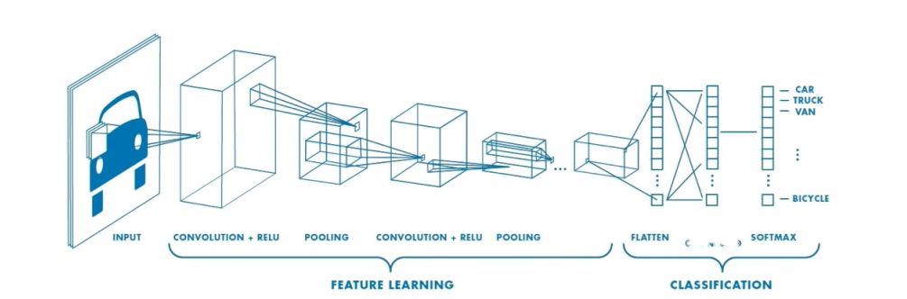
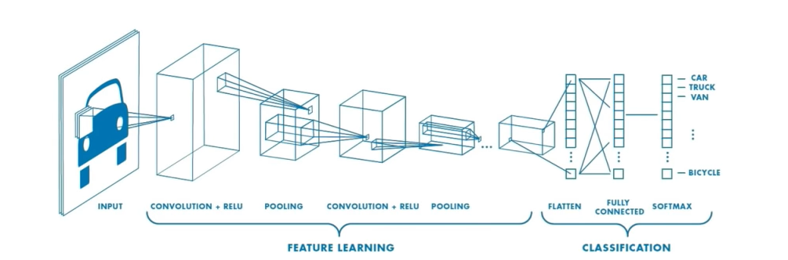
CNNs: Using Spatial Structure
Apply a set of weights to extract local features
Use multiple filters to extract different features
Spatially share parameters of each filter
Input
Fully Connected
Convolution + RELU
Pooling
Convolution + RELU
Pooling
Flatten
Softmax
Feature Learning
Classification

Slide 34
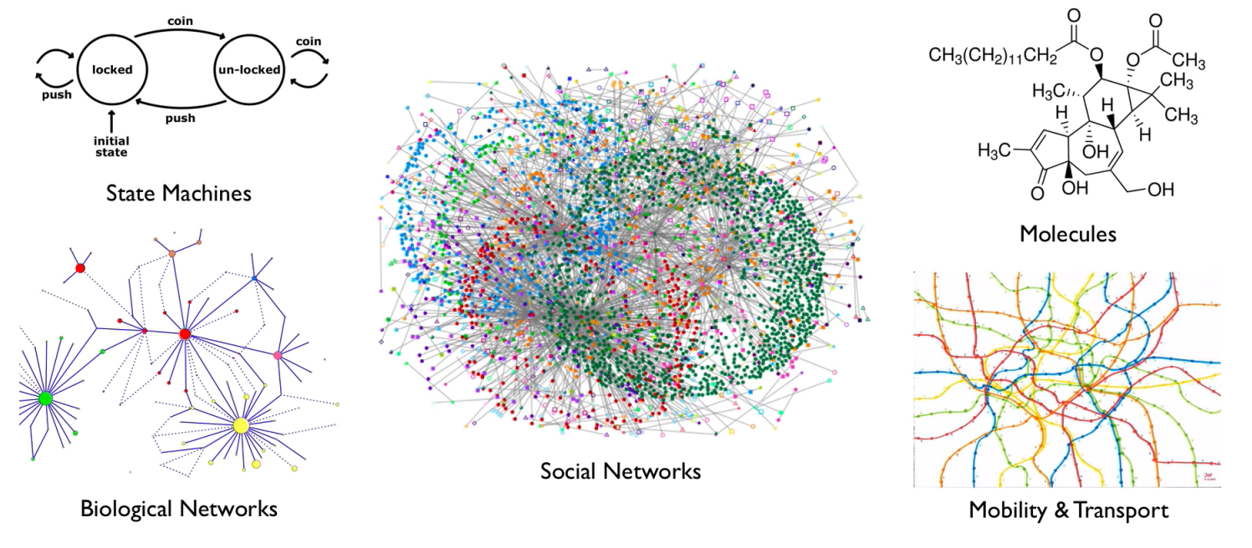
Graphs as a Structure for Representing Data
State Machines
Molecules
Social Networks
Biological Networks
Mobility & Transport

Slide 35
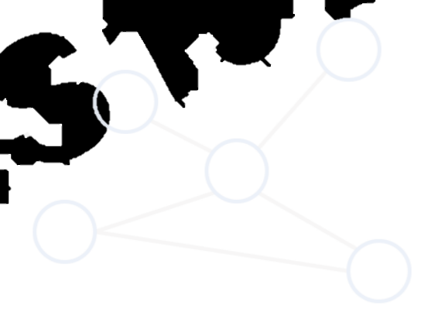
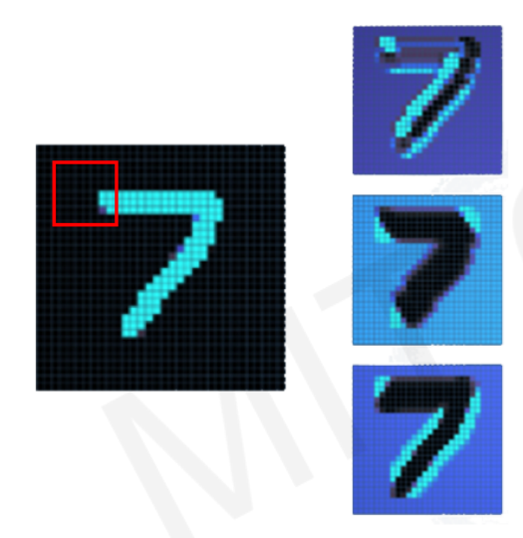
Graph Convolutional Networks
Convolutional Networks
Graph Convolutional Networks (GCNs)

Slide 36
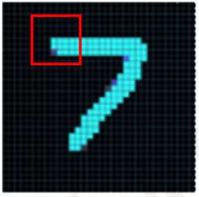
Graph Convolutional Networks
Convolutional Networks
Graph Convolutional Networks (GCNs)

Slide 37
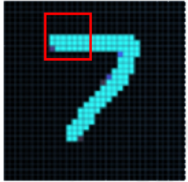
Graph Convolutional Networks
Convolutional Networks
Graph Convolutional Networks (GCNs)

Slide 38
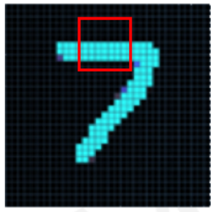
Graph Convolutional Networks
Convolutional Networks
Graph Convolutional Networks (GCNs)

Slide 39

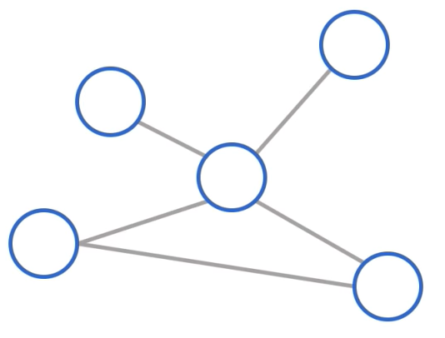
Graph Convolutional Networks
Convolutional Networks
Graph Convolutional Networks (GCNs)

Slide 40
Graph Convolutional Networks
Convolutional Networks
Graph Convolutional Networks (GCNs)

Slide 41
Graph Convolutional Networks
Convolutional Networks
Graph Convolutional Networks (GCNs)

Slide 42
Graph Convolutional Networks
Convolutional Networks
Graph Convolutional Networks (GCNs)

Slide 43
Graph Convolutional Networks
Convolutional Networks
Graph Convolutional Networks (GCNs)

Slide 44
Graph Convolutional Networks
Convolutional Networks
Graph Convolutional Networks (GCNs)

Slide 45
Graph Convolutional Networks
Convolutional Networks
Graph Convolutional Networks (GCNs)
Friday: Graph neural networks for odor prediction Alex Wiltschko, Google Brain

Slide 46
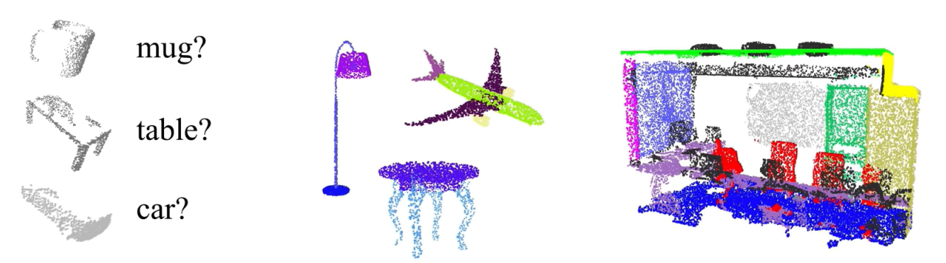
Learning From 3D Data
Point clouds are unordered sets with spatial dependence between points
mug?
table?
car?
Classification
Part Segmentation
Semantic Segmentation

Slide 47
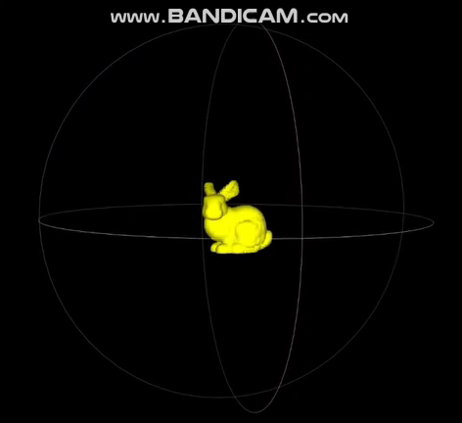
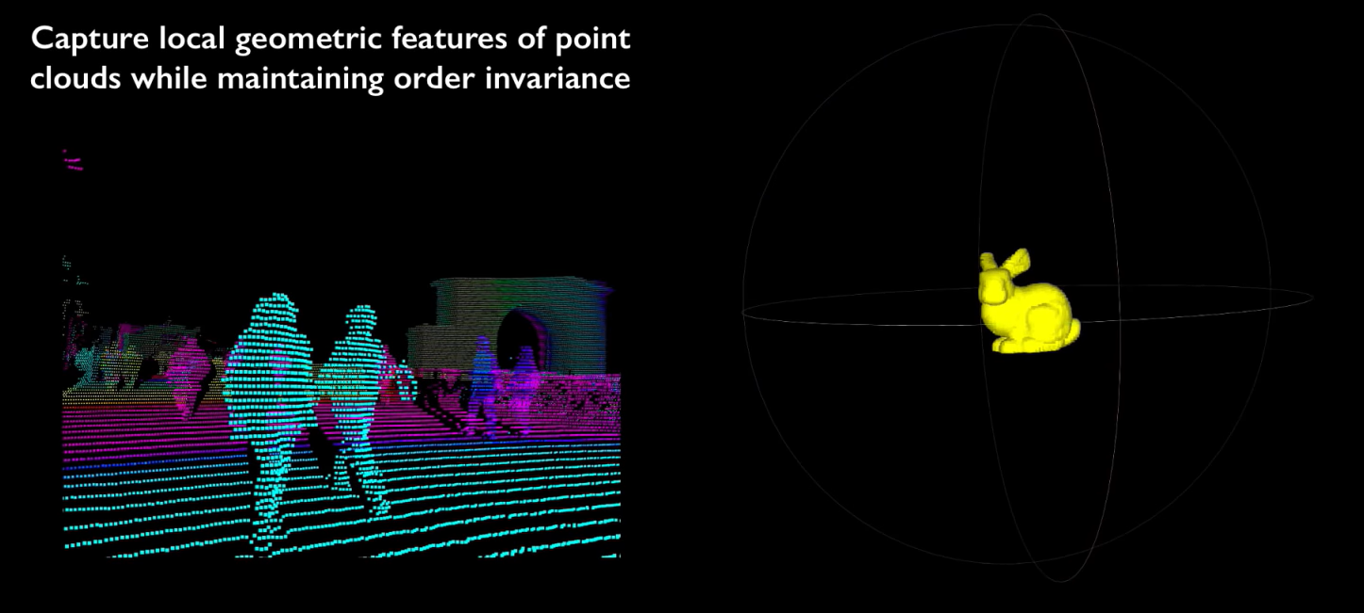
Extending Graph CNNs to Pointclouds
Capture local geometric features of point clouds while maintaining order invariance

Slide 48
New Frontiers II:
Uncertainty Estimation & Bayesian Deep Learning

Slide 49
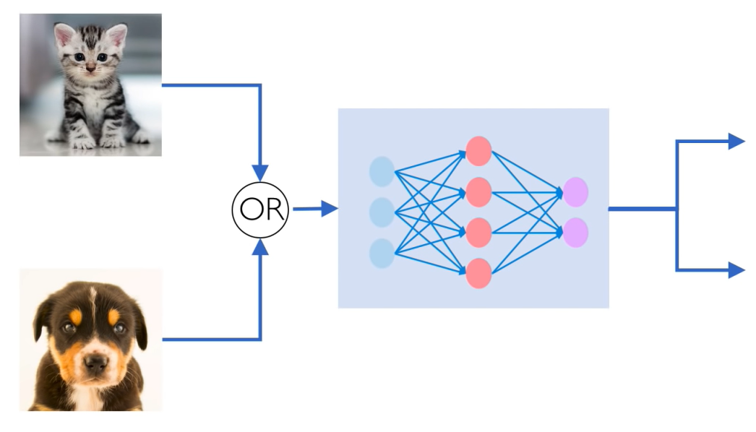
Why care about uncertainty?
P (cat)
P (dog)

Slide 50
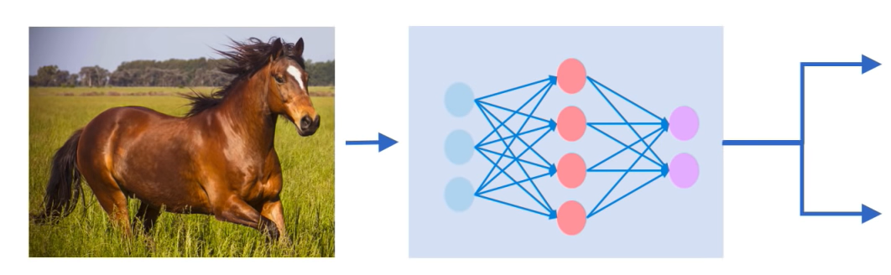
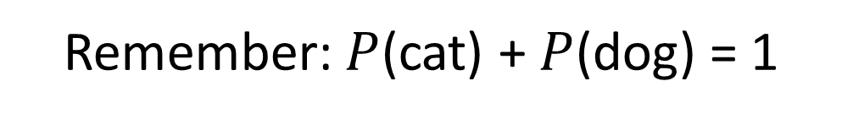
Why care about uncertainty?
We need uncertainty metrics to assess the network’s confidence in its predictions.
P (cat) = 0.2
P (dog) = 0.8
Remember: $P$(cat) + $P$(dog) = 1

Slide 51
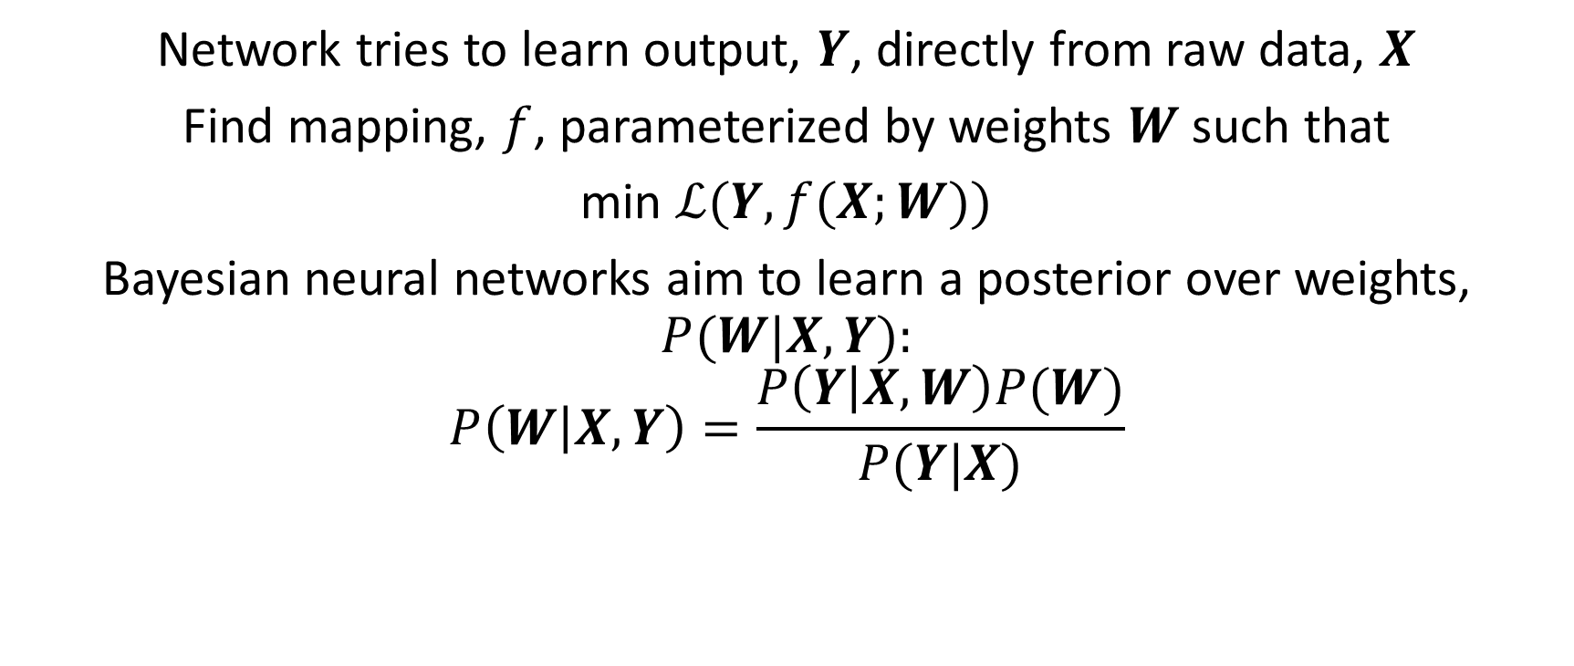
Bayesian Deep Learning for Uncertainty
Network tries to learn output, $Y$, directly from raw data, $X$
Find mapping, $f$, parameterized by weights $W$ such that
min $ℒ(Y, f(X;W))$
Bayesian neural networks aim to learn a posterior over weights,
$$P(W|X, Y):$$
$$P\left(W | X, Y\right)=\frac{P\left(Y | X, W\right)P(W)}{P(Y|X)}$$

Slide 52
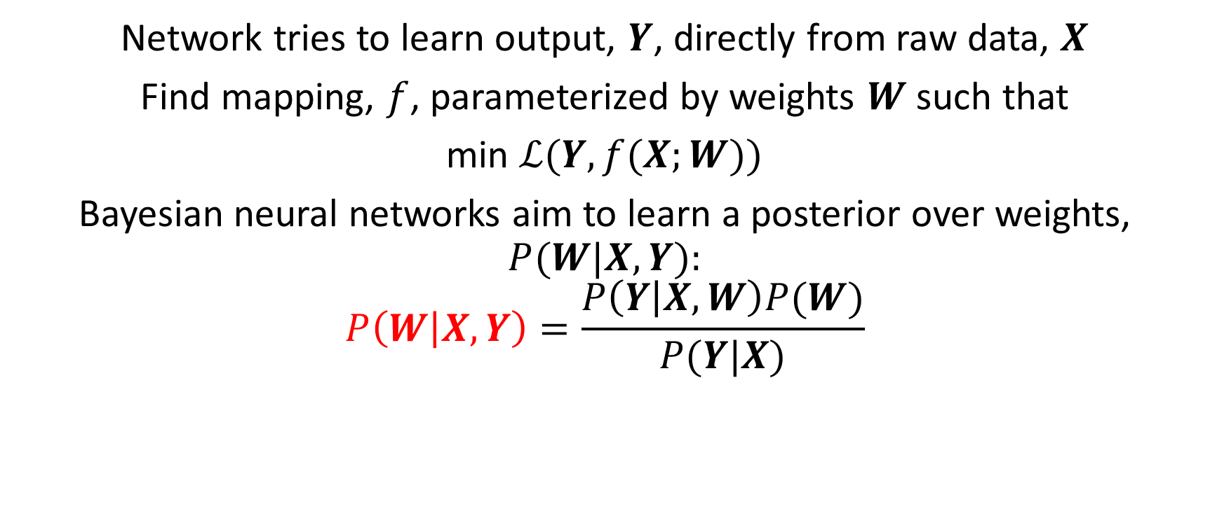
Bayesian Deep Learning for Uncertainty
Network tries to learn output, $Y$, directly from raw data, $X$
Find mapping, $f$, parameterized by weights $W$ such that
min $ℒ(Y, f(X;W))$
Bayesian neural networks aim to learn a posterior over weights,
$$P(W|X, Y):$$
$$P\left(W | X, Y\right)=\frac{P\left(Y | X, W\right)P(W)}{P(Y|X)}$$
Intractable

Slide 53
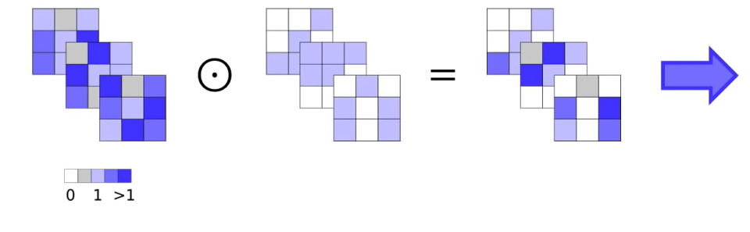
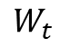
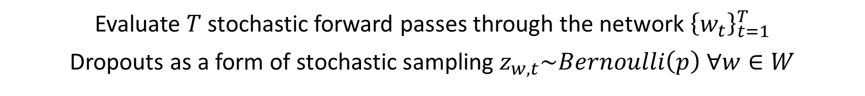
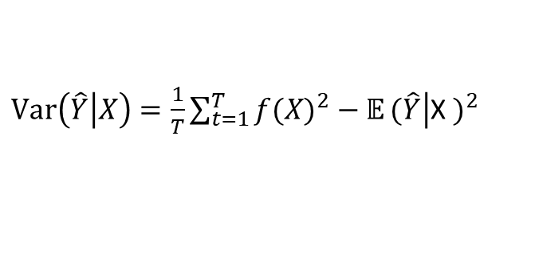
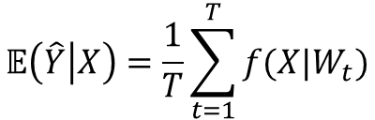


Dropout for Uncertainty
Evaluate $T$ stochastic forward passes through the network ${\left\{w_{t}\right\}}_{t=1}^{T}$
Dropouts as a form of stochastic sampling $z_{w,t}\sim Bernoulli\left(p\right) ∀w∈W$
Unregularized Kernel
Bernoulli Dropout
Stochastic Sampled
$$W$$
$$z_{w,t}$$
$$W_{t}$$
$$\text{𝔼}\left(\left.\hat{Y}\right|X\right)=\frac{1}{T}\sum_{t=1}^{T}{f(X|W_{t})}$$
$Var\left(\left.\hat{Y}\right|X\right)=\frac{1}{T}\sum_{t=1}^{T}{f(X)^{2}−\text{𝔼}}(\left.\hat{Y}\right|$X $)^{2}$
0 1 >1

Slide 54
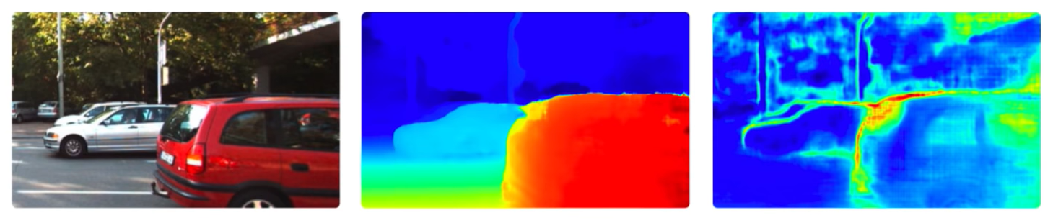
Model Uncertainty Application
Input Image
Predicted Depth
Model Uncertainty

Slide 55
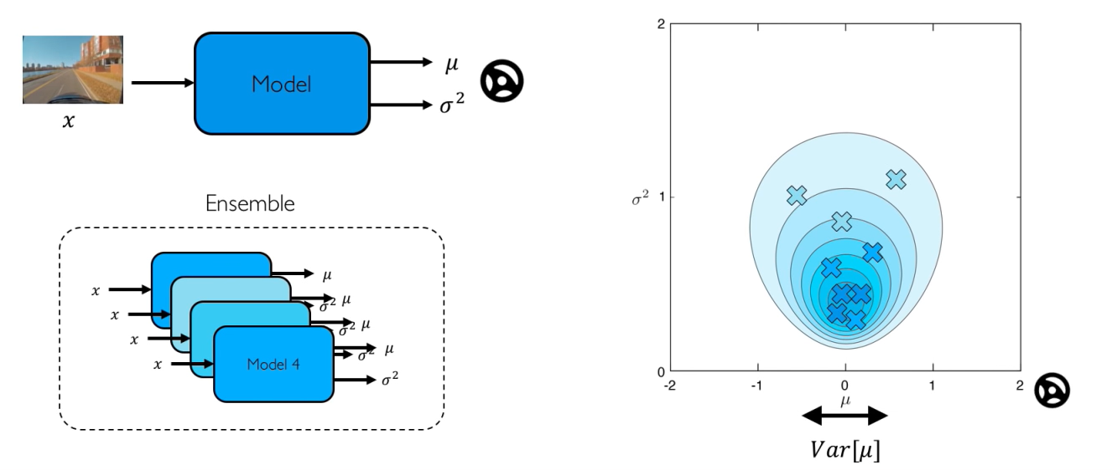
Uncertainty Estimation via Ensembling
Model ensembling for estimating uncertainty
© Alexander Amini and Ava Soleimany MIT 6.S191: Introduction to Deep Learning IntroToDeepLearning.com

Slide 56
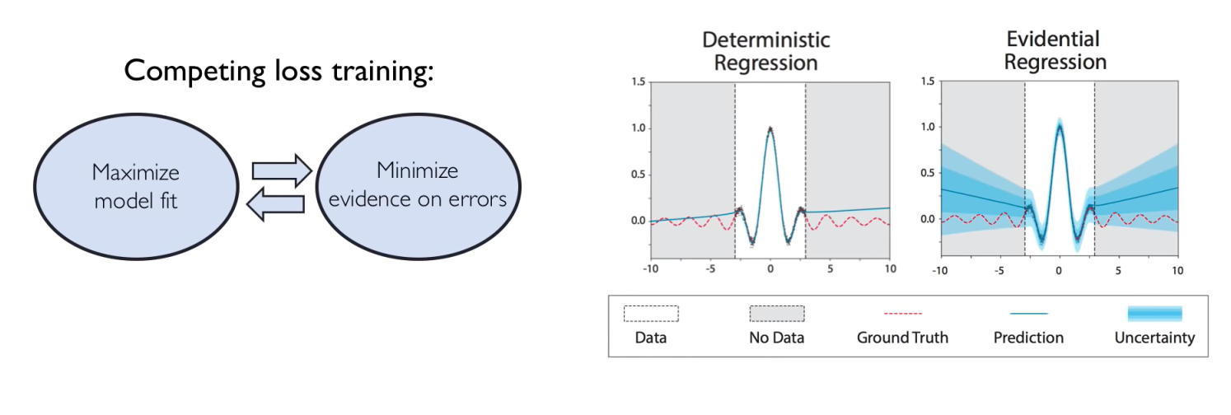
Evidential Deep Learning
Directly learn the underlying uncertainties using evidential distributions
Deterministic Regression
Evidential Regression
Competing loss training:

Slide 57
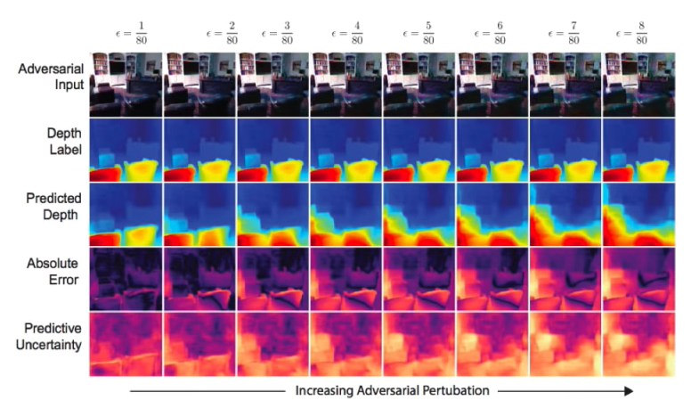

Evidential Deep Learning
Directly learn the underlying uncertainties using evidential distributions
Competing loss training:
Robustness to adversarial perturbation

Slide 58

Multi-Task Learning Using Uncertainty
© Alexander Amini and Ava Soleimany MIT 6.S191: Introduction to Deep Learning IntroToDeepLearning.com

Slide 59

Multi-Task Learning Using Uncertainty

Slide 60
New Frontiers III:
Automated Machine Learning

Slide 61

Motivation: Automated Machine Learning
Standard deep neural networks are optimized for a single task
Often require expert knowledge to build an architecture for a given task
Complexity of models increases
Greater need for specialized engineers

Slide 62
Motivation: Automated Machine Learning
Standard deep neural networks are optimized for a single task
Often require expert knowledge to build an architecture for a given task
Build a learning algorithm that learns which model to use to solve a given problem
Complexity of models increases
Greater need for specialized engineers

Slide 63
Motivation: Automated Machine Learning
Standard deep neural networks are optimized for a single task
Often require expert knowledge to build an architecture for a given task
Build a learning algorithm that learns which model to use to solve a given problem
AutoML
Complexity of models increases
Greater need for specialized engineers

Slide 64
Automated Machine Learning (AutoML)
Sample architecture A with probability p
The controller (RNN)
Trains a child network with architecture
A to get accuracy R
Compute gradient of p and scale it by R to update the controller

Slide 65

AutoML: Model Controller
At each step, the model samples a brand new network
© Alexander Amini and Ava Soleimany MIT 6.S191: Introduction to Deep Learning IntroToDeepLearning.com

Slide 66

AutoML: The Child Network
Sampled network from RNN
Training Data
Prediction
Compute final accuracy on this dataset.
Update RNN controller based on the accuracy of the child network after training.

Slide 67

AutoML on the Cloud

Slide 68


